Slide 1

Dr. Ammar Haider
Assistant Professor
School of Computing
CS3002 Information Security
Introduction to Information Security
Content source: Whitman & Mattord, chapters 1-2, Stallings SPP Chap 1

Slide 2
Course Outline
Please refer to course outline for details of CLOs, evaluations and topic schedule

Slide 3
What Is Security?
“A state of being secure and free from danger or harm; the actions taken to make someone or something secure.”
Information Security
The protection of information and its critical elements, including systems and hardware that use, store, and transmit that information
Includes information security management, data security, and network security

Slide 4
Components of an Information System
Information system (IS) is the entire set of people, procedures, and technology that enable business to use information.
Software
most difficult to secure
easy target
Hardware
require physical security policies

Slide 5
Components of an Information System
Data
Often most valuable asset
Main target of intentional attacks
People
Weakest link
Target of social engineering
Must be well trained and informed

Slide 6
Components of an Information System
Procedures
Written instructions for business tasks
Provide details on how system works
Networks
Securing the data in transit
Block outsiders from access (firewalls)

Slide 7
Characteristics of Information
Any piece of information will have one or more of the following characteristics. Goal of information security is to maintain these characteristics.
Confidentiality
Disclosure or exposure to unauthorized individuals or system is prevented
Integrity
Information as a whole is complete, uncorrupted
Availability
No interference or obstruction when information is needed
Notes:
Critical Characteristics of Information
The value of information comes from the characteristics it possesses.
Availability – Enables users who need to access information to do so without interference or obstruction and in the required format. The information is said to be available to an authorized user when and where needed and in the correct format.
Accuracy – Free from mistake or error and having the value that the end user expects. If information contains a value different from the user’s expectations due to the intentional or unintentional modification of its content, it is no longer accurate.
Authenticity –The quality or state of being genuine or original, rather than a reproduction or fabrication. Information is authentic when it is the information that was originally created, placed, stored, or transferred.
Integrity – The quality or state of being whole, complete, and uncorrupted. The integrity of information is threatened when the information is exposed to corruption, damage, destruction, or other disruption of its authentic state.
Utility – The quality or state of having value for some purpose or end. Information has value when it serves a particular purpose. This means that if information is available, but not in a format meaningful to the end user, it is not useful.
Possession – The quality or state of having ownership or control of some object or item. Information is said to be in possession if one obtains it, independent of format or other characteristic. While a breach of confidentiality always results in a breach of possession, a breach of possession does not always result in a breach of confidentiality.

Slide 8
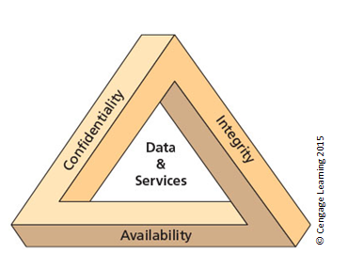
The C.I.A. triad

Slide 9
Characteristics of Information
Some more sub-characteristics worth mentioning
Accuracy
Factual, free from errors
Authenticity
Quality or state of being genuine, e.g., sender of an email
Utility
Timeliness - No value if it is too late
Notes:
Critical Characteristics of Information
The value of information comes from the characteristics it possesses.
Availability – Enables users who need to access information to do so without interference or obstruction and in the required format. The information is said to be available to an authorized user when and where needed and in the correct format.
Accuracy – Free from mistake or error and having the value that the end user expects. If information contains a value different from the user’s expectations due to the intentional or unintentional modification of its content, it is no longer accurate.
Authenticity –The quality or state of being genuine or original, rather than a reproduction or fabrication. Information is authentic when it is the information that was originally created, placed, stored, or transferred.
Confidentiality – The quality or state of preventing disclosure or exposure to unauthorized individuals or systems.
Integrity – The quality or state of being whole, complete, and uncorrupted. The integrity of information is threatened when the information is exposed to corruption, damage, destruction, or other disruption of its authentic state.
Utility – The quality or state of having value for some purpose or end. Information has value when it serves a particular purpose. This means that if information is available, but not in a format meaningful to the end user, it is not useful.
Possession – The quality or state of having ownership or control of some object or item. Information is said to be in possession if one obtains it, independent of format or other characteristic. While a breach of confidentiality always results in a breach of possession, a breach of possession does not always result in a breach of confidentiality.

Slide 10
Characteristics of Information
Some more sub-characteristics worth mentioning
Accountability
Actions of a user are uniquely traceable
Helps in after-attack recovery and finding the culprit
Privacy
Keeping individual’s Personally Identifiable Information (PII) secret
Notes:
Critical Characteristics of Information
The value of information comes from the characteristics it possesses.
Availability – Enables users who need to access information to do so without interference or obstruction and in the required format. The information is said to be available to an authorized user when and where needed and in the correct format.
Accuracy – Free from mistake or error and having the value that the end user expects. If information contains a value different from the user’s expectations due to the intentional or unintentional modification of its content, it is no longer accurate.
Authenticity –The quality or state of being genuine or original, rather than a reproduction or fabrication. Information is authentic when it is the information that was originally created, placed, stored, or transferred.
Confidentiality – The quality or state of preventing disclosure or exposure to unauthorized individuals or systems.
Integrity – The quality or state of being whole, complete, and uncorrupted. The integrity of information is threatened when the information is exposed to corruption, damage, destruction, or other disruption of its authentic state.
Utility – The quality or state of having value for some purpose or end. Information has value when it serves a particular purpose. This means that if information is available, but not in a format meaningful to the end user, it is not useful.
Possession – The quality or state of having ownership or control of some object or item. Information is said to be in possession if one obtains it, independent of format or other characteristic. While a breach of confidentiality always results in a breach of possession, a breach of possession does not always result in a breach of confidentiality.

Slide 11
Threats to information security
Vulnerability: weakness in an asset
Threat: A potential security harm to an asset, caused by exploiting the vulnerability
Attack: An act exploiting a vulnerability. Threat being realized.
Attack Types
Active
Passive
Attack Origin
Inside
Outside

Slide 12
Examples of Attacks/Threats
Packet Sniffing
Monitor data traveling over the network
IP Spoofing
Modify the sender address in IP header
Man-in-the-middle (MITM) attacks
Hijacking the session to delete or forge the data in transit

Slide 13
Examples of Attacks/Threats
Human error or failure
Carelessness of employees
Shoulder surfing
Social engineering
using social skills to convince people to reveal confidential information
Psychological pressure
Showing acquaintance with company’s procedures and habits
Phishing: Sending spoofed but genuine-looking messages to targets

Slide 14
Examples of Attacks/Threats
Malware: malicious software
Virus
Spreads quickly
Attached to a host file (exe, document)
Worms
Do not require a host file
Can self-replicate and self-propagate over local network
Trojans
Disguised as an essential or useful software

Slide 15
Examples of Attacks/Threats
Hacking
Deeply examine the target system
Bypass security controls using skills and/or fraud
After a successful attack, next step is privilege escalation
The higher the privilege, the more the possible harm

Slide 16
Examples of Attacks/Threats
Expert hacker
Develop software scripts and program exploits
Will often create attack software and share with others
Novice hacker
Use expertly written software to exploit a system
Do not usually fully understand the systems they hack

Slide 17
Examples of Attacks/Threats
Password attacks
Cracking: guess or reverse
Cracking techniques:
Brute force: Application of computing and network resources to try every possible combination of characters of a password
Dictionary: Uses a list of commonly used passwords (the dictionary) as guesses

Slide 18
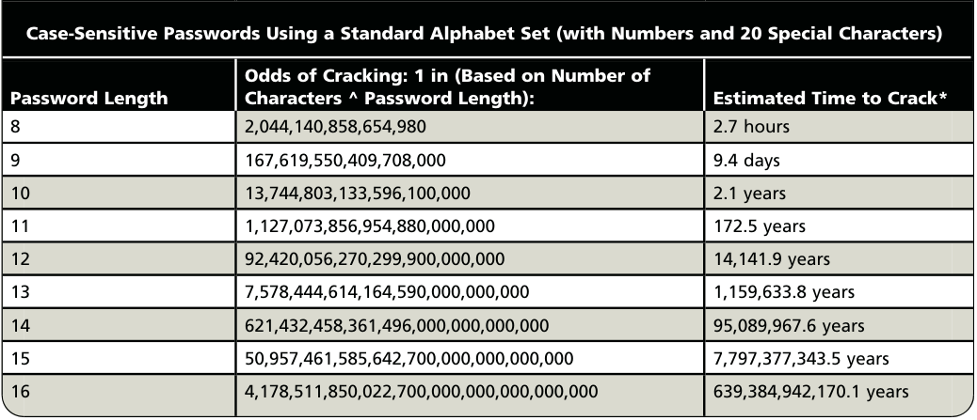
Examples of Attacks/Threats
Brute force hash cracking time estimate

Slide 19
Examples of Attacks/Threats
Money extortion by blackmail
after data theft
after data hostage: ransomware
Vandalism
e.g. defacing public websites
Destroy image of the business

Slide 20
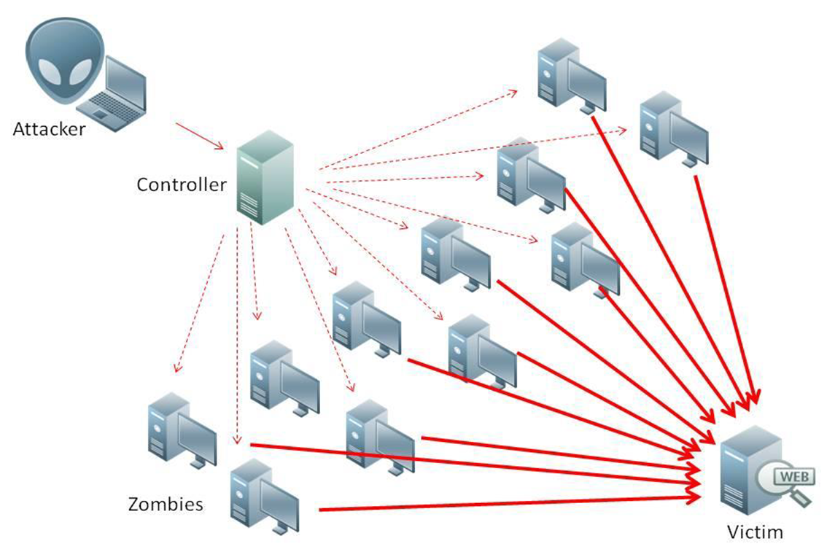
Examples of Attacks/Threats
Bots: Used to launch Distributed Denial- of-Service (DDoS) attacks
Hundreds or thousands of devices are compromised (zombies) and remotely activated by attacker
https://www.pcmag.com/how-to/what-is-ddos-attack-distributed-denial-of-service

Slide 21
Examples of Attacks/Threats
Copyright Infringement
Piracy
Internet Service Issues
Outage (downtime) or degradation
Power blackouts and faults

Slide 22
Examples of Attacks/Threats
Cyberterrorism
Attacks affecting widespread users
Cyberwarfare
State-sponsored attacks against rival states

Slide 23
Examples of Attacks/Threats
Forces of nature
Natural disasters
Require planning in advance:
disaster recovery plan
business continuity plan
incident response plan

Slide 24
Attacks and Consequences
Consequence | Attack
Unauthorized Disclosure | Exposure: Sensitive data are directly released to an unauthorized entity. Interception: An unauthorized entity directly accesses sensitive data traveling between authorized sources and destinations. Inference: A threat action whereby an unauthorized entity indirectly accesses sensitive data (but not necessarily the data contained in the communication) by reasoning from characteristics or by-products of communications. Intrusion: An unauthorized entity gains access to sensitive data by circumventing a system’s security protections.
Stallings, Table 1.2
Memorizing these terms is not required

Slide 25
Attacks and Consequences
Consequence | Attack
Deception An authorized entity receiving false data and believing it to be true. | Masquerade: An unauthorized entity gains access to a system or performs a malicious act by posing as an authorized entity. Falsification: False data deceive an authorized entity. Repudiation: An entity deceives another by falsely denying responsibility for an act.
Stallings, Table 1.2
Memorizing these terms is not required

Slide 26
Attacks and Consequences
Consequence | Attack
Disruption. | Incapacitation: Prevents or interrupts system operation by disabling a system component. Corruption: Undesirably alters system operation by adversely modifying system functions or data. Obstruction: A threat action that interrupts delivery of system services by hindering system operation.
Usurpation An unauthorized entity taking control of system services or functions | Misappropriation: An entity assumes unauthorized logical or physical control of a system resource. Misuse: Causes a system component to perform a function or service that is detrimental to system security.
Stallings, Table 1.2
Memorizing these terms is not required

Slide 27
Causes of Insufficient Security
Networks are insecure: (most) communications are made in clear
LANs operate in broadcast
Geographical connections are not made through end-to-end dedicated lines but:
through shared lines
through third-party routers
weak user authentication (normally password-based)
Software is not sufficiently tested, bugs and weaknesses remain

Slide 28
Causes of Insufficient Security
Weakest link in the chain: Human beings
Low problem understanding (awareness)
Making mistakes when overloaded, stressed etc.
Natural tendency to trust
Complex interfaces/architectures can annoy or mislead the user and originate erroneous behaviors
Naive users are an easy target (e.g. “change your password immediately with the following one, because your PC is under attack”) ...
…but experienced users are targeted too

Slide 29
Causes of Insufficient Security
“Defensive strategies are reactionary”
“Thousands - perhaps millions - of system with weak security are connected to the Internet”
“Increasingly complex software is being written by programmers who have no training in writing secure code”
“Attacks and attack tools transcend geography and national boundaries”
“The difficulty of criminal investigation of cybercrime coupled with the complexity of international law means that prosecution of computer crime is unlikely”

Slide 30
Security Design Principles
Principles of ….
Least Privilege
Separation of privilege
Fail-safe defaults
Complete mediation
Open design
Economy of mechanism
Least Common Mechanism
Psychological acceptability
These were initially proposed by J. Saltzer and M. Schroeder in “The Protection of Information in Computer Systems” (1975). Although proposed a long time ago, these principles and have withstood the test of time.

Slide 31
Least privilege
Provide bare minimum privileges to a program or user to function properly
Temporary elevation should be relinquished immediately
Advantage
Abuse of privileges is restricted
Damage caused by the compromised user or application is reduced

Slide 32
Separation of Privilege
Access should not be granted based on single condition
Multiple conditions should be required to achieve access to restricted resources
Examples:
Two persons to sign checks
Password login + OTC to perform financial transactions
Notes:
Multiple layers of security

Slide 33
Fail-safe defaults
The default configuration of a system should have a conservative approach…
Default access to an object is none
Explicit access to an object should be given
Examples
Access Control Lists
Firewall rules

Slide 34
Complete mediation
Instead of one-time check, every access to a resource must be checked for compliance with a protection scheme
Do not rely on caching of access information
Creates security vs performance dilemma

Slide 35
Open design
Design of a security mechanism should be open rather than secret
Open design can be reviewed by many experts, their feedback helps in improving it.
Examples:
Encryption algorithms, Network security protocols

Slide 36
Economy of mechanism
Aim for simplicity in design and implementation of security measures
A simple secure framework provides…
Fewer errors
Development, testing and verification of security measures is easy
Less assumptions

Slide 37
Psychological acceptability
Security mechanism should not make the resources difficult to access
User interface should be well designed and intuitive
Security related setting should consider the expectation of ordinary users

Slide 38
Least common mechanism
Minimize mechanisms (or shared variables) common to more than one user and depended on by all users.
Shared mechanisms create possibilities of
Transmitting secret data (covert channels)
Limiting availability (attack on one service impacts others)
This principle recommends “isolation” (e.g. virtual machines, sandboxes)

Slide 39
Attack Vectors and Surfaces
Attack surfaces are different points that an unauthorized user can employ to compromise a system or network.
Each attack surface has its associated risk, likelihood and impact.
Source of input maybe hardware, software, or communication.
Its is important to map out all entry points an attacker can abuse in a system.
Involves creating an architecture diagram.
Tests performed based on priority
Priority = ease of exploitation * impact of exploitation

Slide 40
Attack Surface Mapping
List all components
Prepare architecture diagram
Label components & communication b/w them
Identify attack vectors
Rate attack vectors

Slide 41
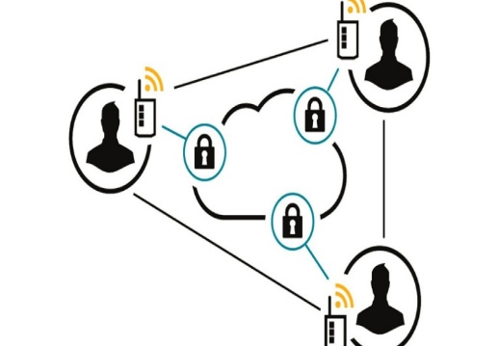
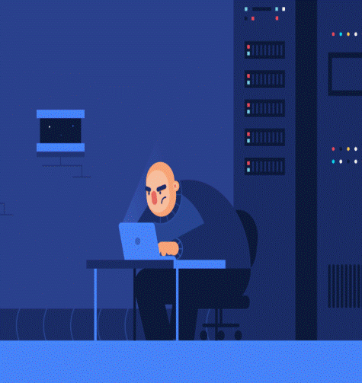
Threat Modeling: STRIDE
Theoretical use cases considered to identify potential threats.
Microsoft STRIDE
S: Spoofing of identity
T: Tampering with data
R: Repudiation
I: Information disclosure
D: Denial of service
E: Elevation of privilege.
Requires realization of assets and vulnerabilities
attack

